Slide 1
Linked Lists
Lecture 8
Ananya Choudhury
COED, SVNIT

Slide 2
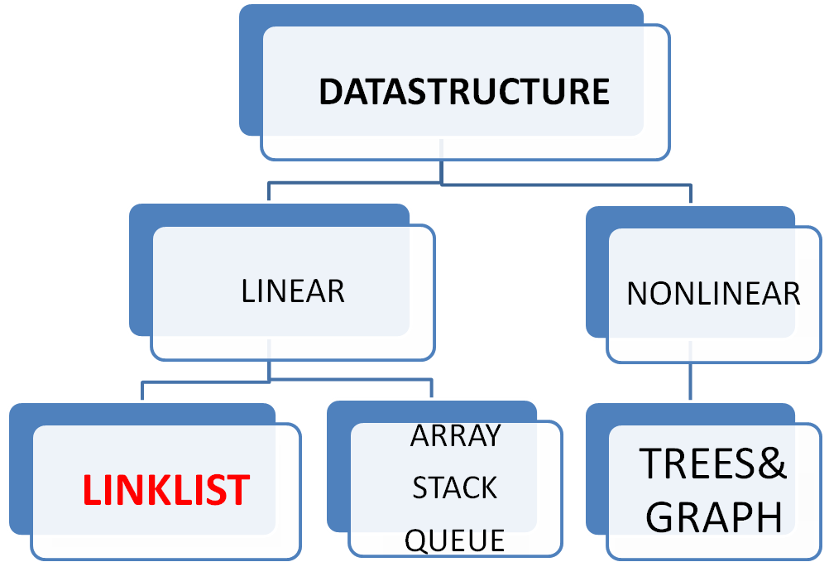

Slide 3
Linked List
What are the problems with Arrays
Size is fixed
Array Items are stored contiguously
Insertions and deletion at particular position is complex
Why Linked list ?
-Size is not fixed
-Data can be stored at any place
-Insertions and deletions are simple and faster

Slide 4
What is Linked List?
A linked list is a collection of nodes with various fields
It contains data field and Address field or Link field
Pointer to the first node
Info field
Link Field/
Address Field

Slide 5
Linked List Types
Singly Linked list
Circular singly linked list
Doubly linked lists
Circular doubly linked lists

Slide 6
Graphical Representation
Singly Linked List
First
10
1000
15
20
NULL
2000
4000
1000
2000

Slide 7
Graphical Representation
Circular Singly Linked List
Last node contains the address of the first node
First
10
1000
15
20
4000
2000
4000
1000
2000

Slide 8
Doubly Linked list
Contains the address of previous node and next node
First
NULL
10
2000
1000
15
3000
2000
20
NULL
1000
2000
3000

Slide 9
Circular Doubly Linked list
Contains the address of first node and last node
First
3000
10
2000
1000
15
3000
2000
20
1000
1000
2000
3000

Slide 10
Representation of Singly Linked list
struct node
{
int info;
struct node *link
};
typedef struct node *NODE;
Meaning of this: A node is of the type struct and contains info field and link filed

Slide 11
What is typedef ?
typedef is a keyword in the C Language used to give the new name to data types.
The intent is to make it easier for programmers
Example typedef int x;
Later on you can use x as a data type
x a, b;
Means a and b are variables of the type integer

Slide 12
Operations on Singly Linked List
INSERT
Insert from front : first node
Insert at end
Insert in middle
DELETE
DISPLAY THE CONTENTS
SEARCH THE LINKED LIST
First
10
1000
15
20
NULL
2000
4000
1000
2000

Slide 13
INSERTION IN LINKED LIST
List is empty
The node inserted becomes the first node.
List is not empty
The node inserted is added to the node at a particular position
Insert from front
Insert at end
Insert in middle

Slide 14
Algorithm to Insert an Element from the front
1 temp=allocate memory
2 temp(info)=item;
3 link(temp)=first;
4 call temp as first
5 temp <- newnode
6 return first;
temp
NULL
NULL
30
NULL
Temp node with item

Slide 15
Allocation of memory to newnode
newnode =( NODE ) malloc (sizeof(struct node));
It Returns address of the location with piece of memory of the size struct. That is for information field and address field

Slide 16
Insert from the front
Operations on Singly Linked List
First
temp
10
1000
15
20
NULL
2000
4000
1000
2000
temp->link=first,

Slide 17
Insert from the front
Operations on Singly Linked List
First
10
1000
15
20
NULL
2000
4000
1000
2000
first=temp

Slide 18
C Function to Insert an Element from the front
Insertfront(NODE first int item)
{
NODE temp;
temp=(NODE) malloc(sizeof(struct node));
temp->info=item;
temp->link=NULL ;
temp->link=first;
first=temp;
return(temp);
}

Slide 19
Algorithm to Display the content
// Algorithm Display
if (first==NULL)
write list empty
return;
Write “ Contents of the List ”
temp=first
While(temp!=NULL)
{
write (info(temp))
temp=link(temp)
}

Slide 20
Algorithm to Delete from the front
1 if (first==NULL)
Write list empty and return first
3 temp=first
4 first=link(first)
5 free(temp)
6 return(first)

Slide 21
C Function to Delete the element from the front
NODE deletefront(NODE first)
{
if (first==NULL)
{ printf(List is empty..\n”);
return first;
}
temp=first;
first=first->link;
printf(“ The ietm deleted is %d”,temp->info);
free(temp);
return(first);
}

Slide 22
Delete from the front
Operations on Singly Linked List
Temp/First
10
1000
15
20
NULL
2000
4000
1000
2000
temp=first

Slide 23

Delete from the front
Operations on Singly Linked List
First
10
1000
15
20
NULL
2000
temp
4000
1000
2000
temp=first, first=first->link

Slide 24
Delete from the front
Operations on Singly Linked List
First
15
2000
20
NULL
1000
2000

Slide 25
DISADVANTAGES OF LINKED LIST
Wastage of memory
No random access
Time Complexity
Reverse Traversing is difficult
Heap Space restriction

